Slide 1
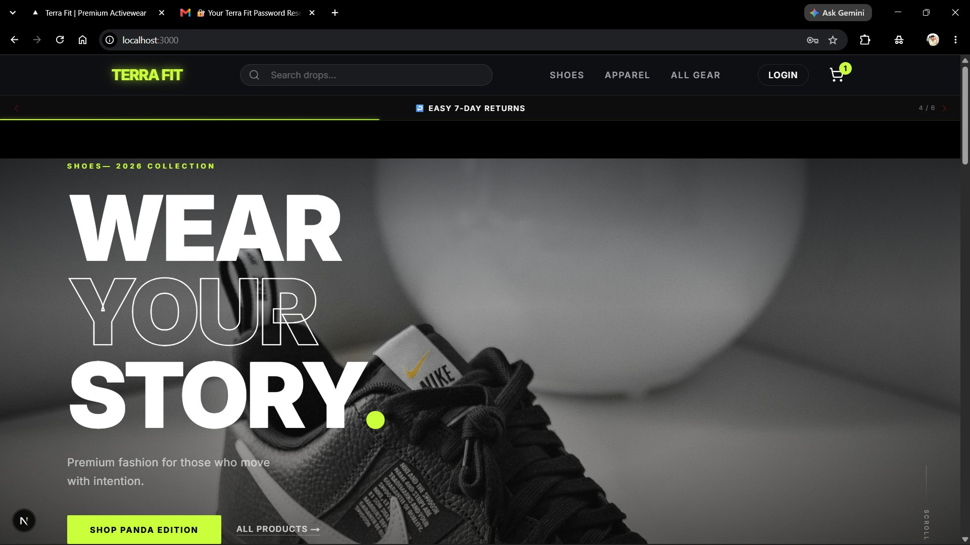
TERRA FIT
TERRA FIT
PREMIUM ACTIVEWEAR
E-Commerce Platform
Next.js
Node.js
MySQL
Razorpay
FULL-STACK PROJECT
A production-ready e-commerce web application for premium fitness activewear, featuring secure authentication, live payment processing, and automated order management.
Tech Stack: Next.js · Node.js · Express · MySQL · Sequelize · Razorpay · Google OAuth · Brevo
1 / 10

Slide 2
01 OVERVIEW
Project Overview
ABSTRACT
2
Servers
(Frontend + Backend)
TerraFit is a full-stack e-commerce platform for selling premium activewear online. It provides a seamless shopping experience with secure authentication, product browsing, cart management, and integrated payment processing via Razorpay.
7+
Integrated
APIs & Services
14+
Pages &
Routes
🔐
💳
📊
📧
Auth
Payments
Sheets
Email
JWT + Google OAuth + OTP
Razorpay Live INR
Auto Order Sync
Brevo Transactional
2 / 10

Slide 3
02 HOMEPAGE
Home Page
● ● ● localhost:3000
HERO SECTION
"Wear Your Story" — 2026 Collection with bold CTA buttons
NAVIGATION
Shoes · Apparel · All Gear · Login · Cart with badge
ANNOUNCEMENT BAR
Easy 7-day returns policy displayed prominently
COLLECTION BADGES
Panda Edition drop · All Products quick link
3 / 10

Slide 4
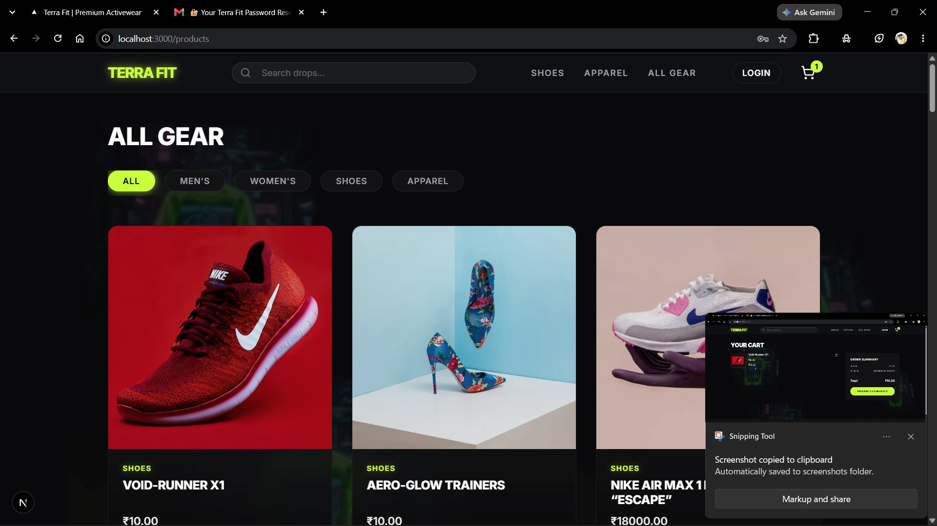
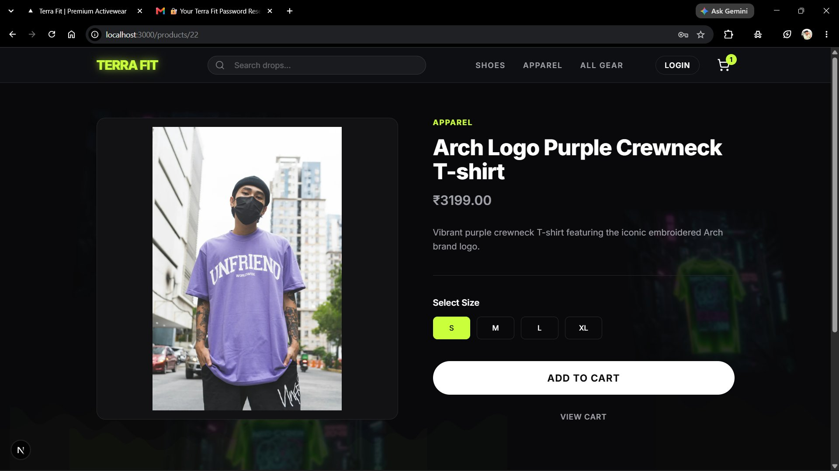
03 PRODUCT CATALOG
Product Pages
● ● ● /products
● ● ● /products/22
Filter by ALL · MEN'S · WOMEN'S · SHOES · APPAREL
Add to Cart + View Cart
Size Selector: S / M / L / XL
Price in INR ₹
4 / 10

Slide 5
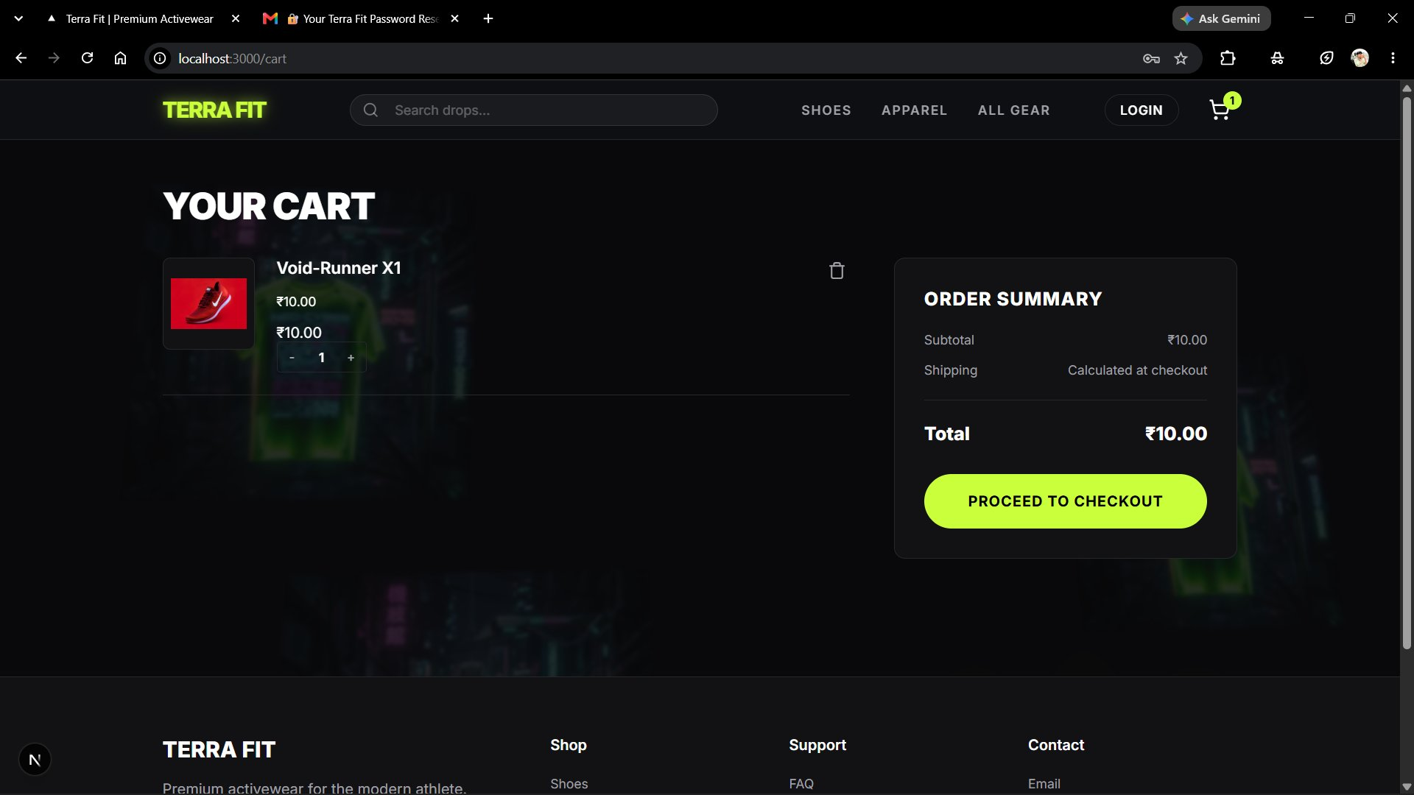
04 CART & CHECKOUT
Cart & Payment Flow
● ● ● /cart
CHECKOUT FLOW
1
Add to Cart
Select size & quantity
2
Checkout Form
Shipping details
3
Razorpay
UPI · Cards · Netbanking
4
Verify Payment
HMAC signature check
5
Order Saved
DB + Google Sheets sync
5 / 10

Slide 6
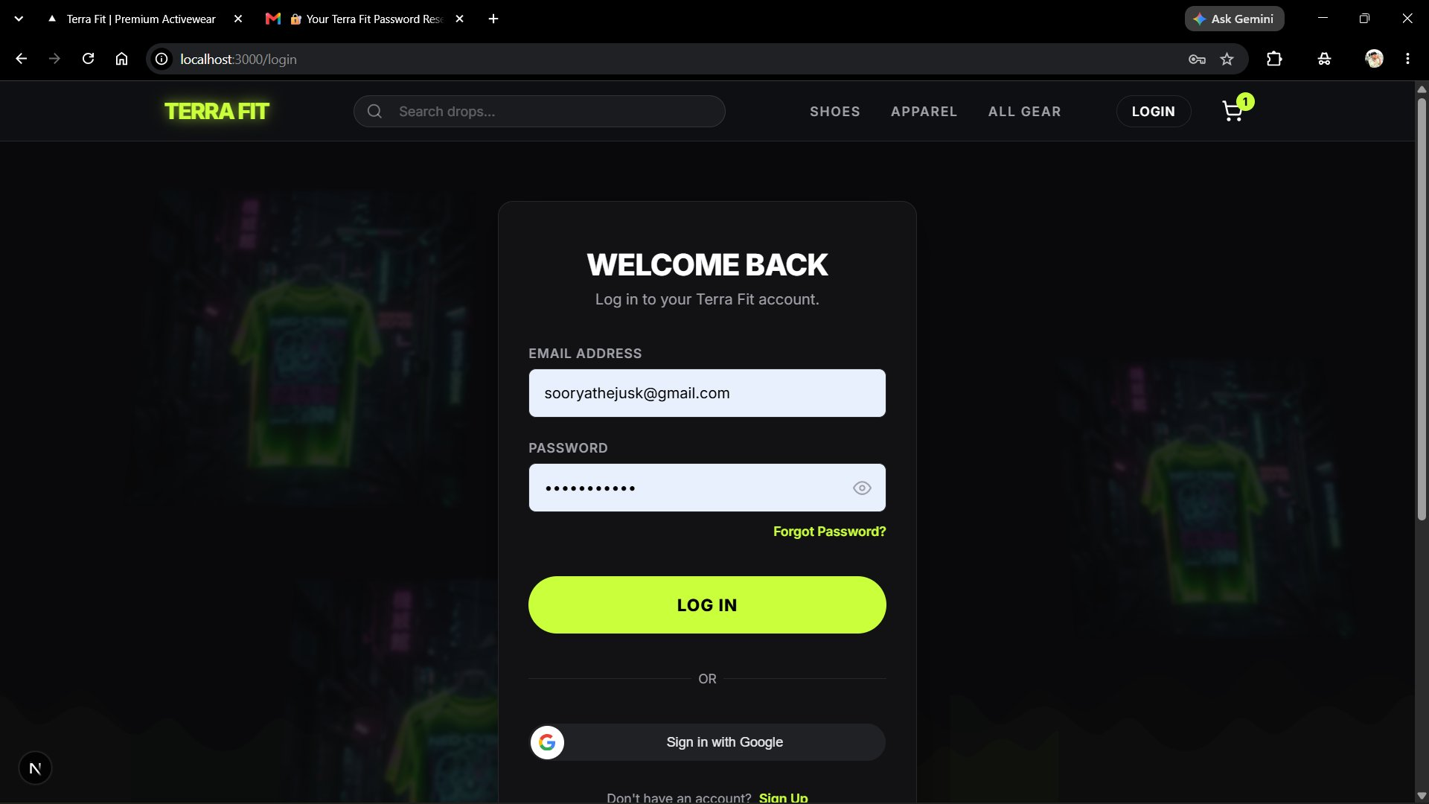
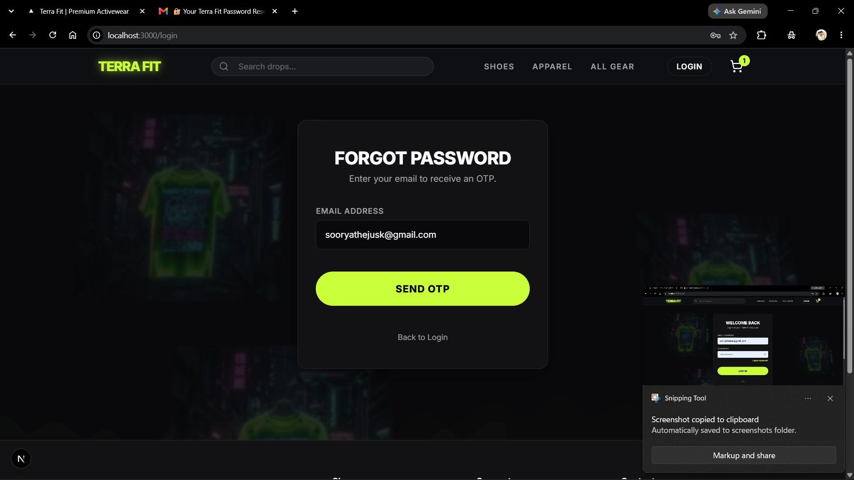
05 AUTHENTICATION
User Authentication
● ● ● /login
● ● ● /login (forgot)
🔑 JWT Auth
🔒 bcrypt
🌐 Google OAuth
📲 OTP Email
Token-based session
Hashed passwords
Sign in with Google
Via Brevo (Sendinblue)
6 / 10

Slide 7
06 TECH STACK
Technology Stack
FRONTEND
BACKEND
SERVICES
Next.js 14+
Node.js + Express
MySQL (XAMPP)
React Framework (App Router)
REST API server
Relational database
TypeScript
Sequelize ORM
Google OAuth 2.0
Type-safe language
MySQL database layer
Social sign-in
CSS Modules
JWT + bcryptjs
Brevo / Sendinblue
Scoped styling
Auth & security
Transactional email
React Context
Razorpay SDK
Google Sheets API
Cart state management
Payment gateway
Order auto-sync
7 / 10

Slide 8
07 DATABASE
Database Design
USER
ORDER
PRODUCT
PK id (INT, AUTO)
name (VARCHAR)
email (VARCHAR, UQ)
password (VARCHAR)
isAdmin (BOOLEAN)
resetPasswordOtp
createdAt / updatedAt
PK id (INT, AUTO)
FK userId (INT)
items (JSON)
totalAmount (DECIMAL)
shippingDetails (JSON)
razorpayOrderId
status: pending/paid/failed
PK id (INT, AUTO)
name (VARCHAR)
price (INT)
description (TEXT)
image (VARCHAR)
category (VARCHAR)
sizes (JSON) / stock (INT)
1 : N (User places many Orders)
MySQL 8.0 · Sequelize ORM · XAMPP
Order stores Products as JSON items array
8 / 10

Slide 9
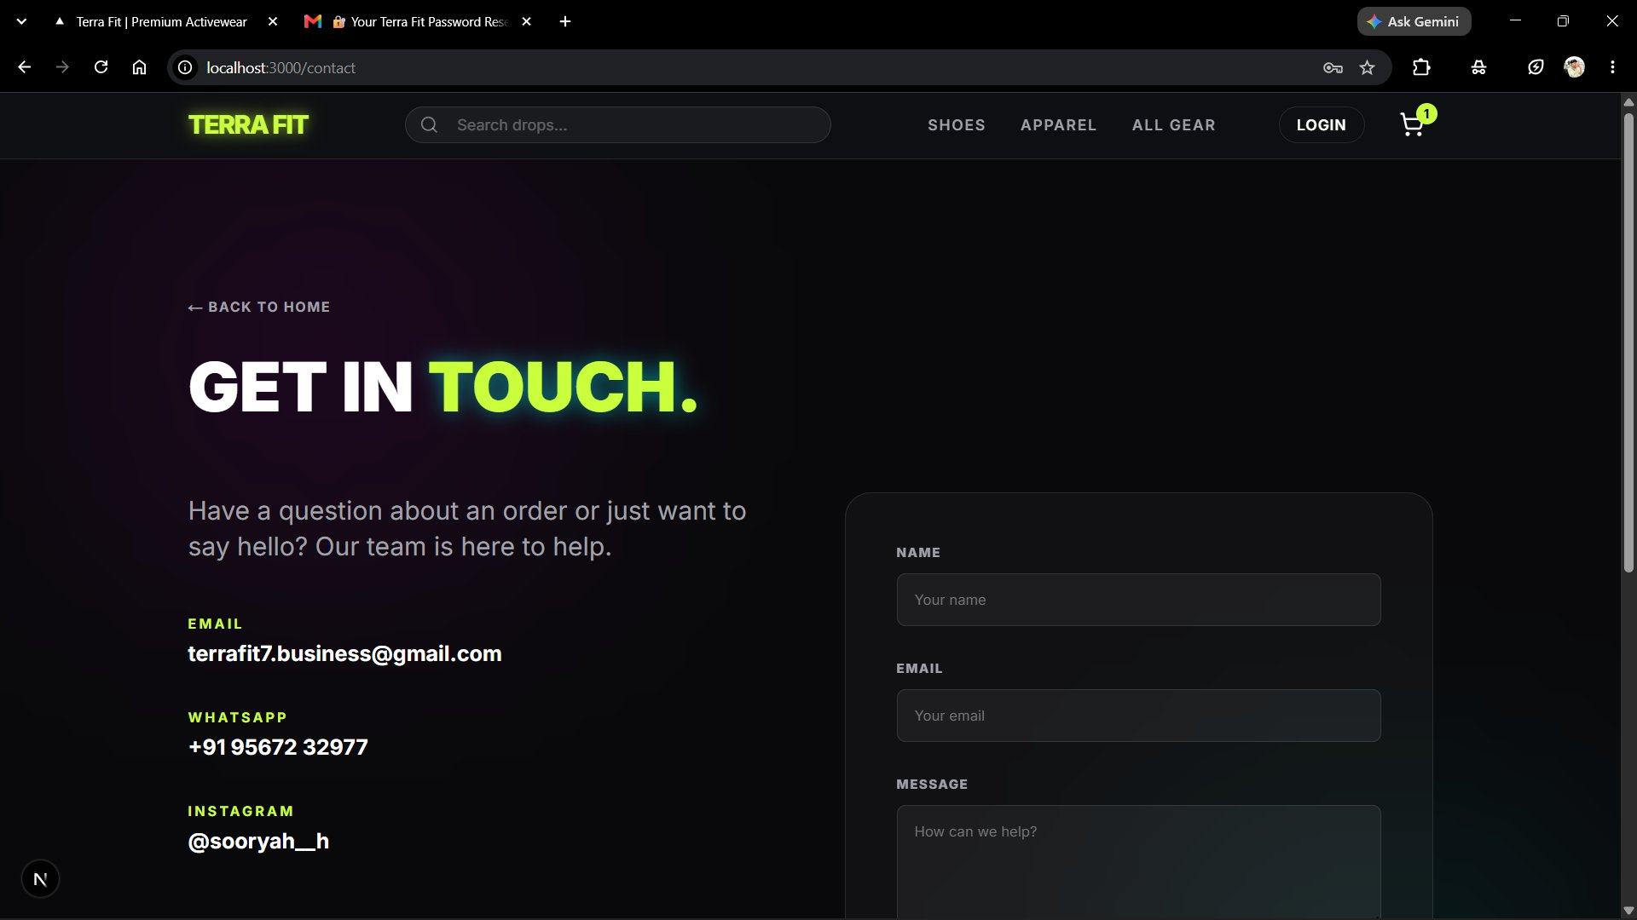
08 FEATURES
Key Features
● ● ● /contact
🔐
Multi-mode Auth
💳
Live Payments
Email + Google + OTP recovery
Razorpay INR — UPI/Cards/Net
📊
Google Sheets
📧
Email OTP
Auto order sync for business
Brevo transactional delivery
🛒
Smart Cart
🔒
HMAC Verify
Context-based state, qty control
Razorpay signature verification
9 / 10

Slide 10
09 CONCLUSION
Conclusion &
Future Scope
WHAT WAS ACHIEVED
FUTURE ENHANCEMENTS
Production-ready full-stack e-commerce platform
Admin Dashboard with analytics
Secure JWT + Google OAuth + OTP authentication
Product Reviews & Ratings
Live Razorpay payment with HMAC verification
AI Product Recommendations
Auto Google Sheets order sync for business ops
Real-Time Stock Management
RESTful API with Sequelize ORM + MySQL
PWA / React Native Mobile App
TERRA FIT
THANK YOU
Premium Activewear · E-Commerce Platform
Next.js · Node.js · MySQL · Razorpay · Google OAuth · Brevo
10 / 10

